Slide 1


INTERNSHIP TEAM - 26
PRESENTATION
Developing an Opinionated Sales Forecast
October, 2022

Slide 2

Team Introduction
Olusoji Onigbinde (Data Engineer)
Mercy Gichuhi (Data Engineer)
Daniel Odukoya (Data Scientist)
Lawson Iduku (Data Scientist)

Slide 3
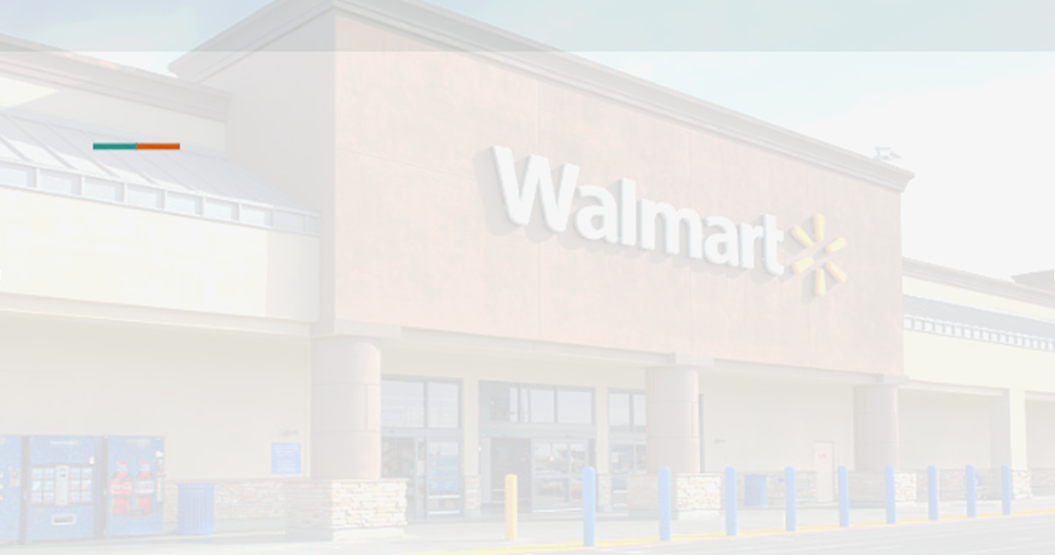

Overview of Presentation
1
Introduction
2
Analytical Insights
3
Architectural Choices
4
Live Demo
5
Recommendations
5
Question & Answer
6
5

Slide 4

Introduction
Develop an accurate forecasting approach that predicts sales per item per store for the next 28 days.
Forecast should take into consideration uncertainty estimates at median, 50%, 67%, 95% and 99% confidence intervals.

Slide 5
What our solution hopes to achieve…
Predict future sales per item per store with uncertainty estimates (confidence intervals) for the next 28 days.
The solution should be able to predict for individual items as well as aggregate item categories.
The pipeline should be robust to sporadic sales.
The pipeline should consider things like historic sale prices, special events throughout the year, promotions, etc.
Future work can focus on extending the solution to also consider other relevant external datasets.

Slide 6

What?
We want to enable retail stores…
Manage rapid daily transaction rates
Balance Inventory & demand
Predict future sales based on history

Slide 7
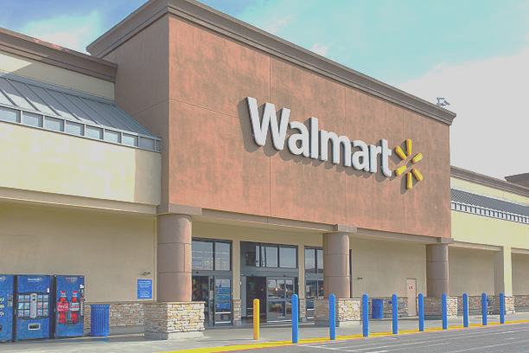
Data Source
Walmart official data (Texas, Wisconsin & California Stores )
Our data set is actual Customer and Transactional Data sourced from 10 Walmart Stores located across 3 cities namely:
California (CA- 4 stores)
Texas (TX- 3 stores)
Wisconsin (WI- 3 stores)

Slide 8
Introducing our Data Structure
TOTAL OF 3 STATES
(CA, TX & WI)
California (CA)
Texas
(TX)
Wisconsin
(WI)
Store
CA-1
Store
CA-2
Store
CA-3
Store
CA-4
Store
TX-1
Store
TX-2
Store
TX-3
Store
WI-1
Store
WI-2
Store
WI-3
Category
Hobbies
Category
Foods
Category
Household
Department
Hobbies 1
Department
Hobbies 2
Department
Foods 1
Department
Foods 2
Department
Foods 3
Department
Household 1
Department
Household 2
Item
1
Item
416
Item
417
Item
565
Item
2003
Item
2564
Item
2535
Item
3049
…
…
…
…
…

Slide 9






Analytical Insights
1
2
3
Data Quality
Exploratory Data Analysis
Feature Engineering
4
5
Developing our Model (LightGBM)
Confidence Intervals

Slide 10
Workload Schema
05
Application demonstration
Data Ingestion
01
04
Model development & Confidence Interval
.
Data Quality Testing
02
03
EDA and Feature Engineering
Notes:
Data Ingestion : Loading the raw data (i.e. our .csv files) into a Jupyter notebook making use of the Pandas library.
Data Quality: A data verification process done with programming code verifying data types of fields, length of characters, formats, and whether the values falls within an acceptable range.
EDA: Analyzing the Data via Histograms, bar charts, pie charts etc. to further understand our data.
Feature Engineering :Manipulation of our data set to improve machine learning model training, better performance and greater accuracy. Effective feature engineering is based on sound knowledge of the business problem and the available data sources.
.
Confidence Interval : Predicting future sales per item per store (using LightGBM Model) with uncertainty estimates for the next 28 days, i.e. per day predict the median, 50%, 67%, 95% and 99% confidence intervals.

Slide 11
Analytical Insights
(Exploratory Data Analysis)

Slide 12
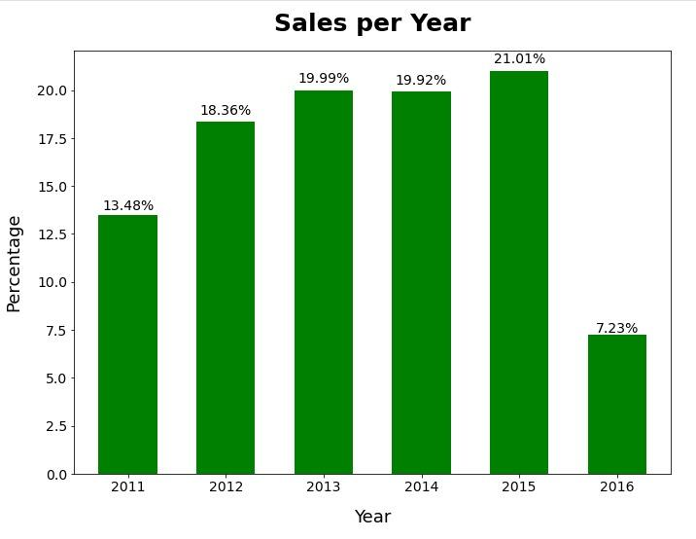
YEARLY ITEM SALES
Notes:
Sales on rapid increase between 2011 -2013 with a slight decrease in 2014 and later increases in 2015. Sales drop in year 2016 is because we do not have a complete dataset in the year 2016 (i.e. only 4 months available in 2016).

Slide 13
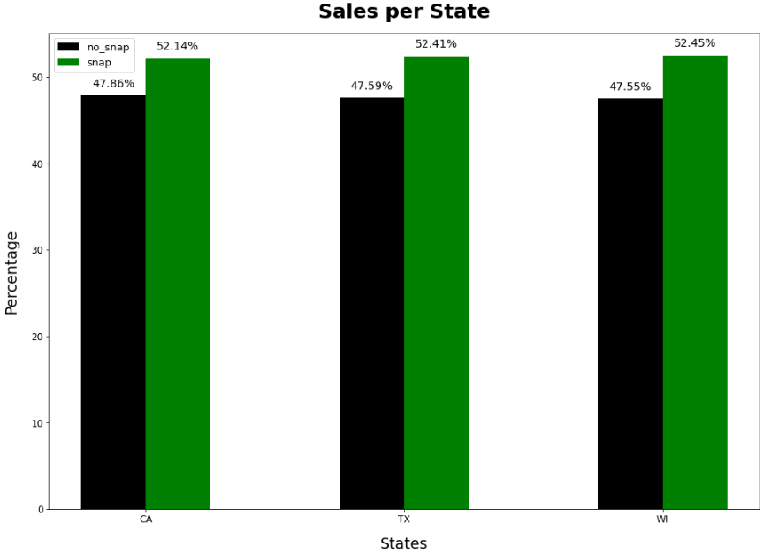
SALES PER STATE BASED ON FOOD STAMPS
Notes:
Sales are higher for days when food stamps are accepted compared to days when food stamps are not accepted.

Slide 14
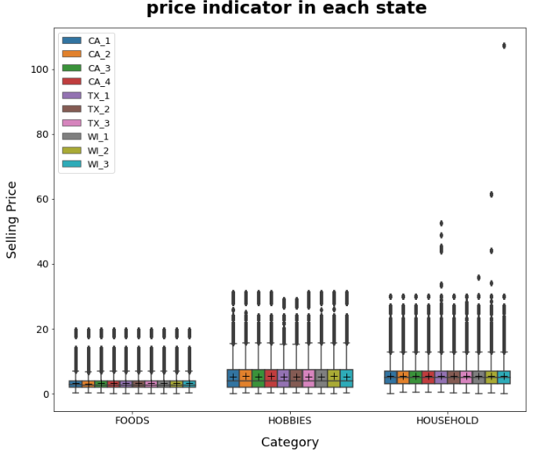
PRICE INDICATOR IN EACH STATE
Notes:
Items within the Foods and Hobbies categories fall within a price range i.e.
0-20 for Foods and
0-38 for Hobbies
Household category however contain some items that fall outside the price range of majority within that category.

Slide 15
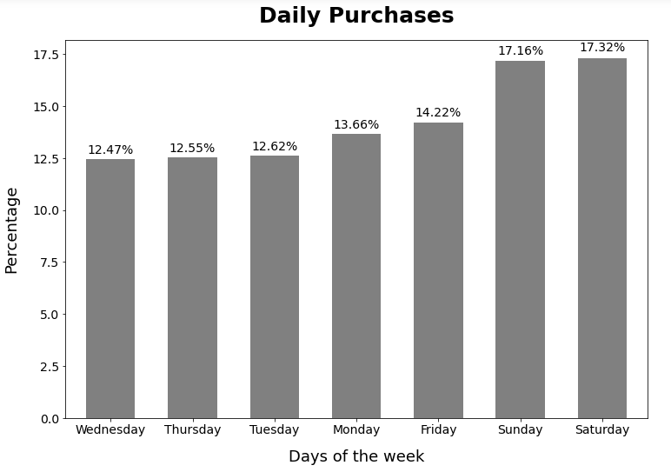
SALES PER DAY
Notes:
Sales are higher during weekends (Friday, Saturday and Sunday) as compared to non weekends.

Slide 16
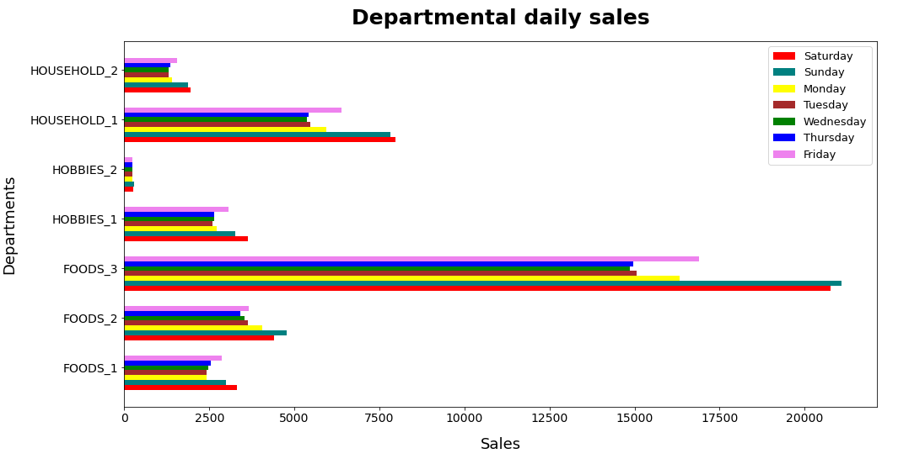
SALES PER DEPARTMENT
Notes:
Saturday and Sunday recorded the highest sales for all categories.

Slide 17
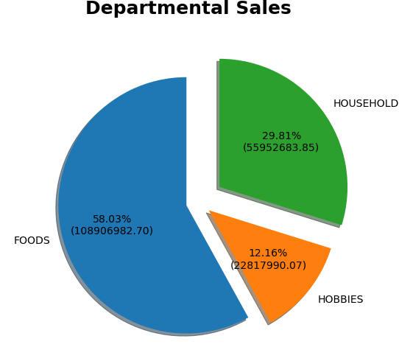
PERCENTAGE INCOME PER DEPARTMENT

Slide 18
Analytical Insights
(Confidence Intervals)

Slide 19

Confidence Intervals
( Why Quantile Regression ?)
Predict sales at given quantiles.
Quantile helps to analyse distribution.
Quantile unveils prediciton accuracy.
For our predictions we made use of 0.5 and 0.99 intervals.
Notes:
Quantile regression helps us create a model that is able to predict sales at given quantiles.
Knowing the sales values within these quantiles allow us to analyze their distribution as well as the probability of their accuracy and eventually the uncertainty of the predictions.
For this chart, due to the resources required to show the visualizations (hardware i.e Memory and C.P.U. ), we displayed only distribution for the highest and lowest quantiles (i.e. quantiles 0.5 and 0.99) as we know that the other quantiles fall within this range.

Slide 20
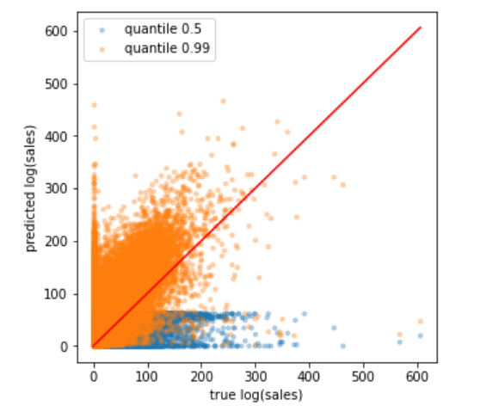
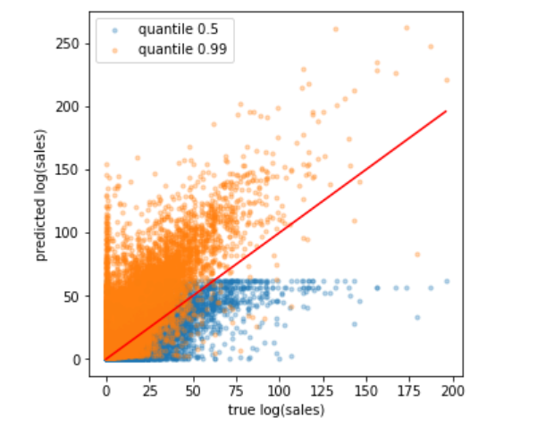
Analytical Insights
Training Data ranges between 1001 - 1885 days.
Test Data ranges between 1914 - 1941 days.
Versus
Notes:
We noticed, the larger the quantile and the more the data, the larger the sales estimate.

Slide 21
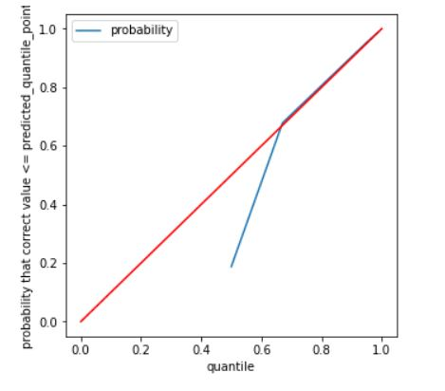
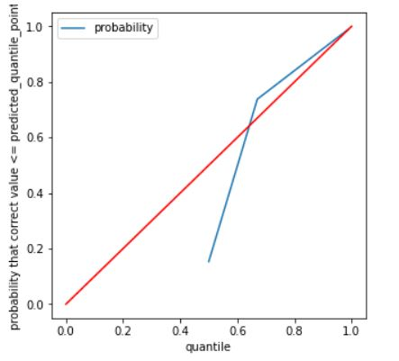
Analytical Insights
Model performance with (884days) training dataset
Versus
Model performance with (28days) Test dataset
Notes:
We noticed the larger the quantile and the more the data, the more accurate the probability.

Slide 22
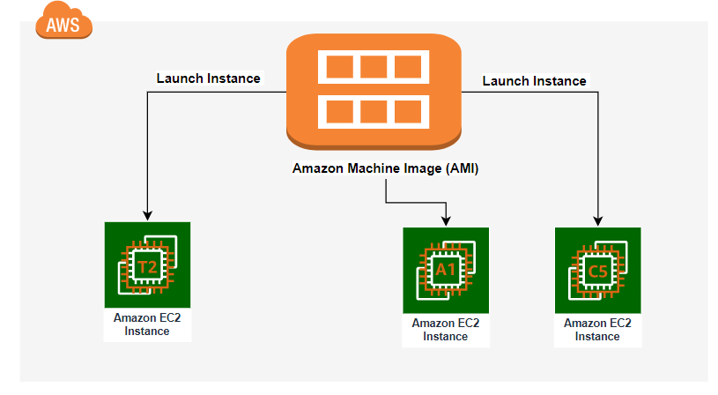







Our Cloud Architecture
?
Operating System virtual environment (Amazon Linux AMI)
Images Folder
Scripts Folder
Data Folder
Compute resource (Amazon E.C.2 Instance)
Streamlit Client
(Front end)
A simplified approach with the use of fewer cloud resources
was favored to make our solution less expensive.
Object Storage (Amazon S3 Bucket)

Slide 23


How it works
A look at our application’s functionallity

Slide 24
LIVE DEMONSTRATION
WITHIN THE CLOUD
TEAM - 26

Slide 25
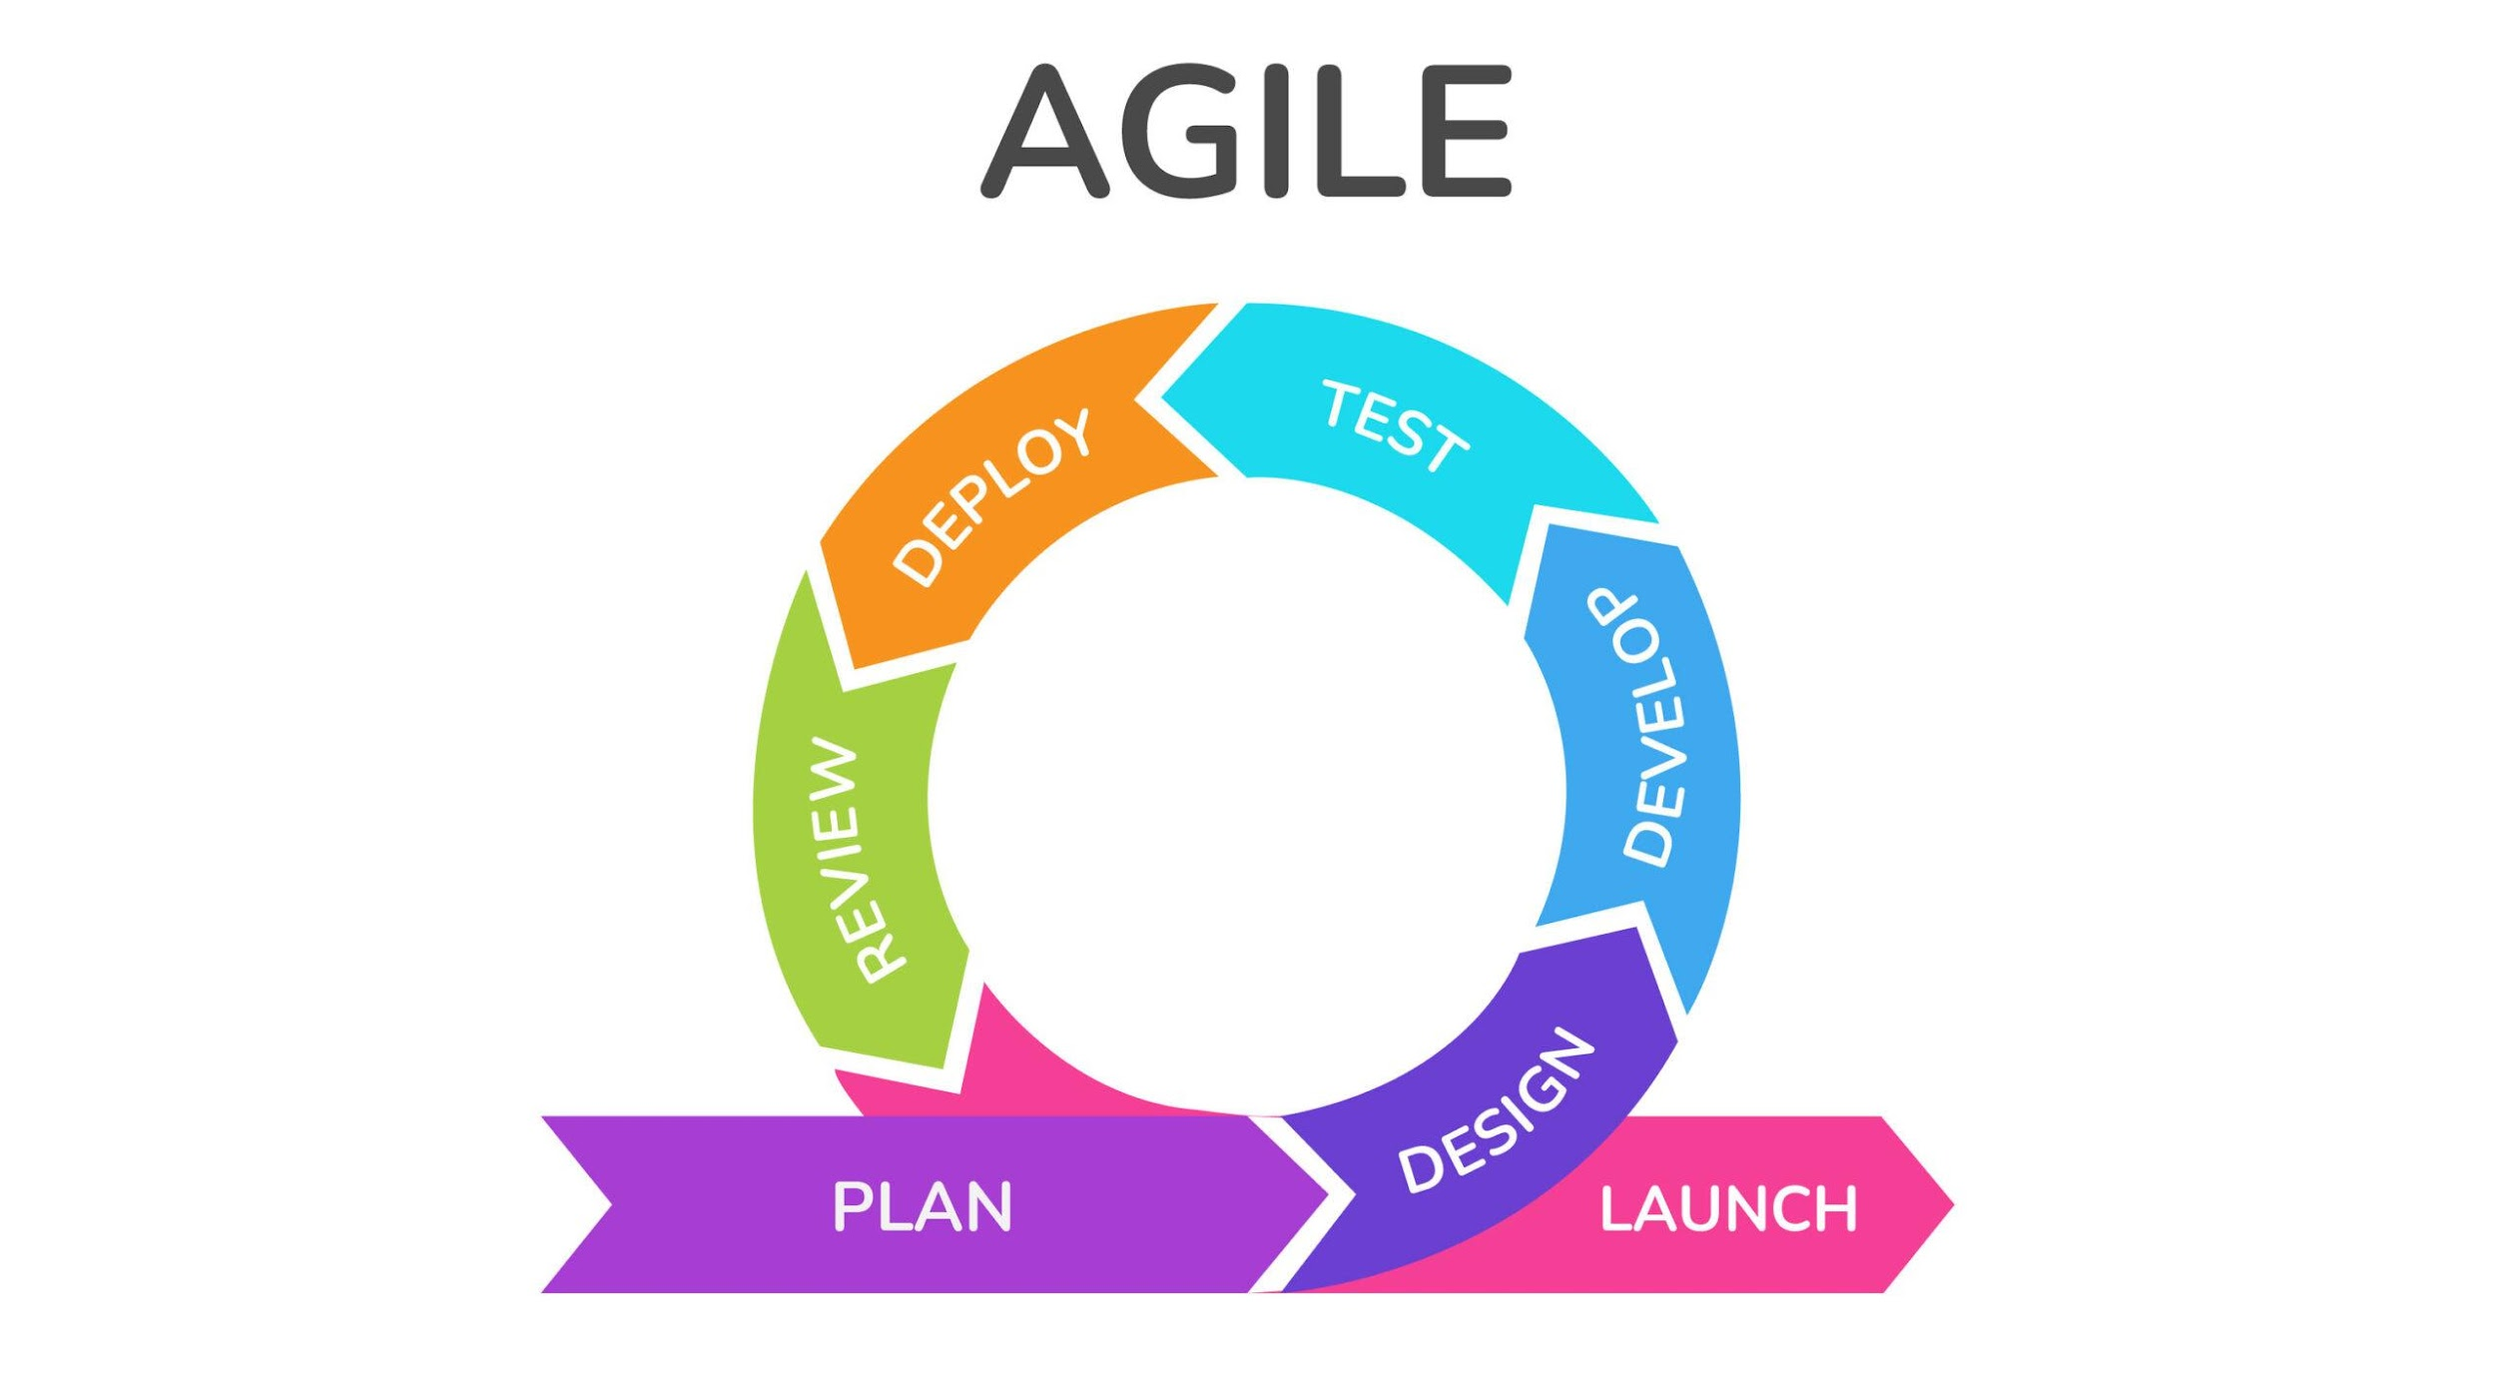
Recommendations
.
Aside LightGBM, other models like XG Boost, Random Forest, Prophet and Arima can be explored as options to improve our solution
An Elastic I.P V4 address and an e-mail service (Amazon SES) can be incorporated to our solution
An AGILE methodology can be applied to our solution for continuous improvement.
A data streaming solution can be incorporated to our pipeline for batch or real time processing of Walmart data

Slide 26
THANK YOU
TEAM - 26

Slide 27
?
QUESTIONS
TEAM - 26

